Slide 1
ME469: Run and Viz
Stefan P. Domino^{1,2}
¹ Computational Thermal and Fluid Mechanics, Sandia National Laboratories
² Institute for Computational and Mathematical Engineering, Stanford
SAND2018-4536 PE

Slide 2
Lecture Objectives
Connect to the cluster
Launch a case
Viz a case

Slide 3
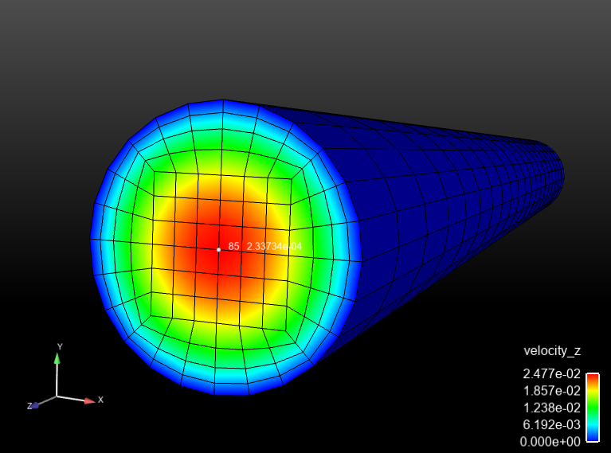
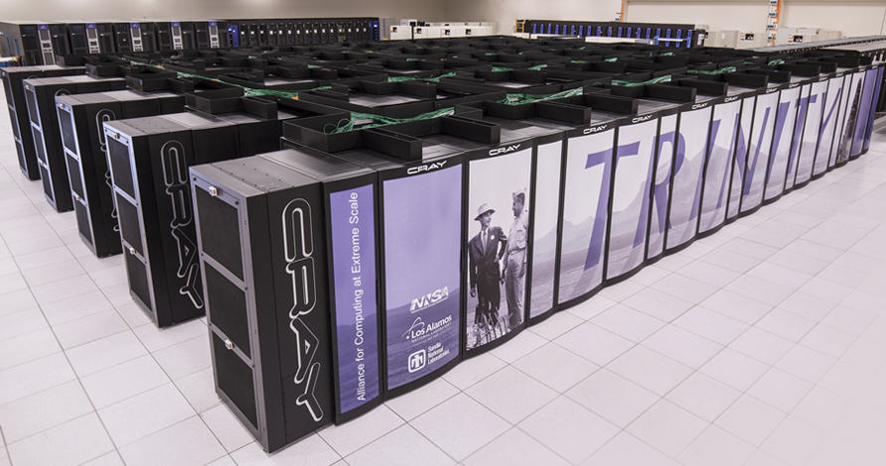
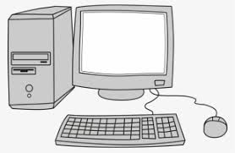

Essential Attributes of a CFD Simulation
Mapping from Real World, to Conceptual Model, and, finally, a Computer Model (given an underlying PDE discretization approach)
Input File(s)
Mesh
mesh: my_mesh.g
euations: my_equations
- inflow_boundary_condition: bc_left
target_name: Inflow
velocity: [1.0,0.0]
mixture_fraction: 0.0
Hex8
Tet4
launch remotely
launch locally
output.log
output.e.32.*
output.rst.32.*
Remote Viz
>scp output.e.32.* /to/my/local/disk

Slide 4
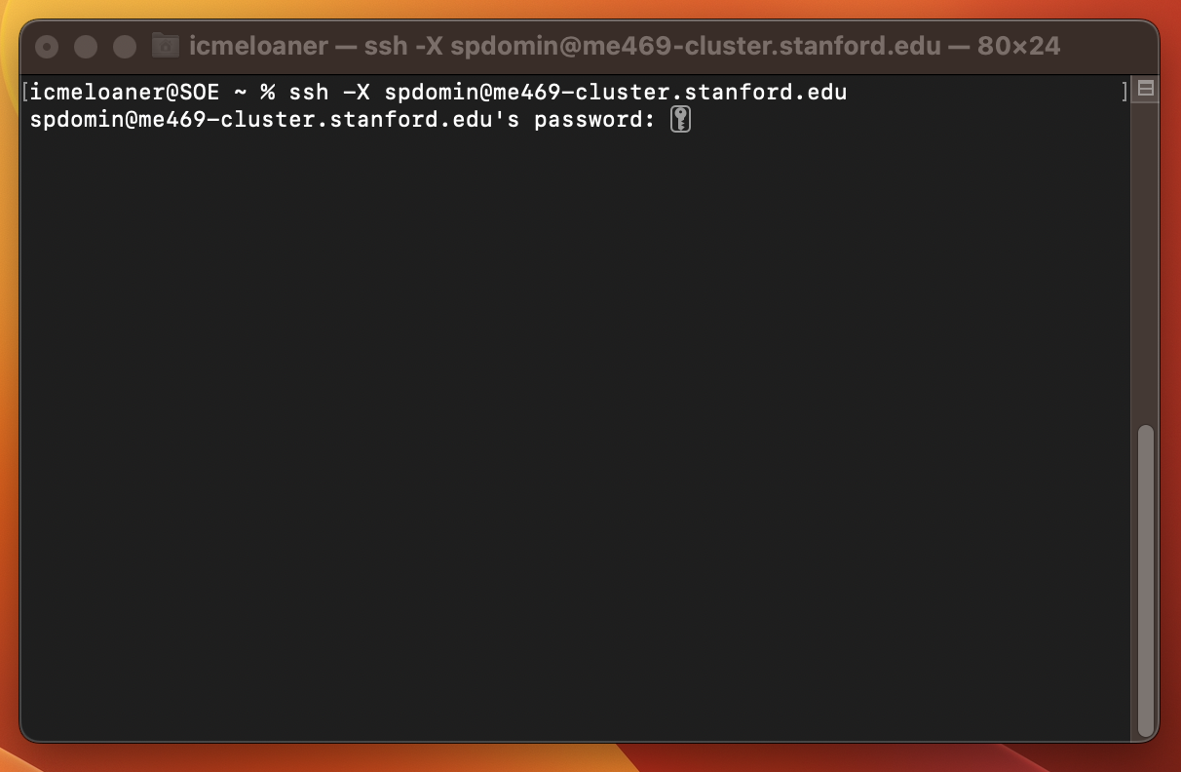
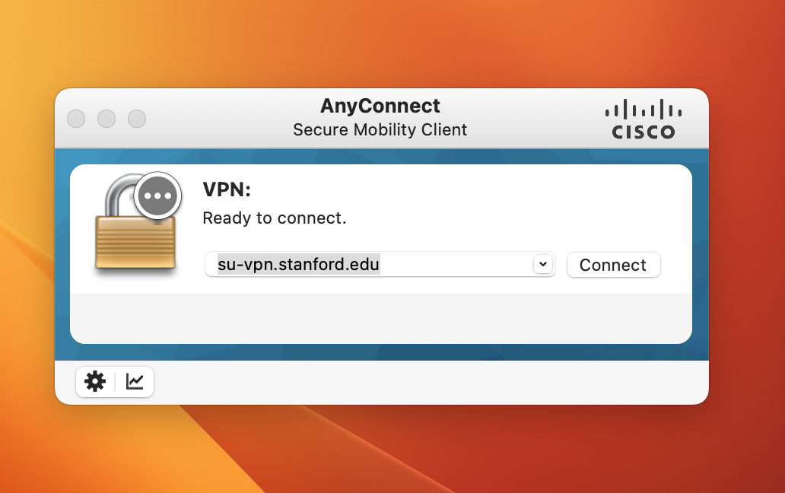
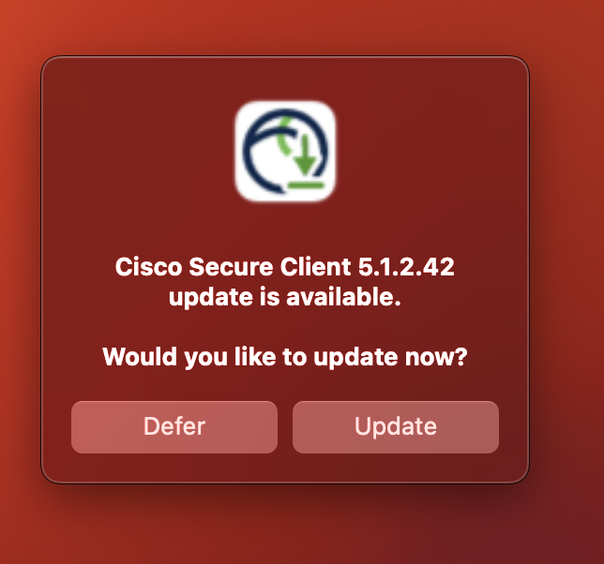
VPN, Followed by SSH (may be prompted to update Cisco SC

Slide 5
Submitting a Job (Refer to “how-to” pdf)
Recall, when you log into the cluster, via:
>ssh –Y {yourUserName}@me469-cluster.Stanford.edu
you will find yourself under:
>pwd
>/home/{yourUsername}
Useful locations:
/shared/scripts (path to nalu.slurm)
/shared/codes/nalu/build/Nalu/build (path to executable, naluX)
/shared/codes/nalu/build/Nalu/reg_tests/test_files (path to regresson tests)
/shared/codes/nalu/build/Nalu/reg_tests/test_files/laboratory (labs – look for 2d_tri3_quad4_street)
Make sure that you have created a particular directory structure that includes:
nalu.slurm
Input file
“Sane” path to mesh and xml file

Slide 6
Sample location for vortex street
Let’s work in the complete vortex street case:
After logging in…
>pwd
/home/spdomin
>cp –r /shared/test-cases/vortex-street ./
>cd vortex-street
>sbatch nalu.slurm
That’s it! Now check the run via:
>squeue

Slide 7
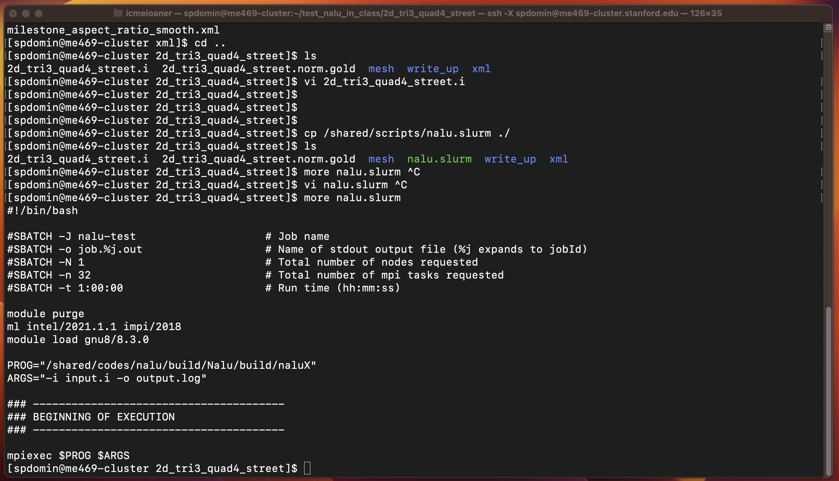
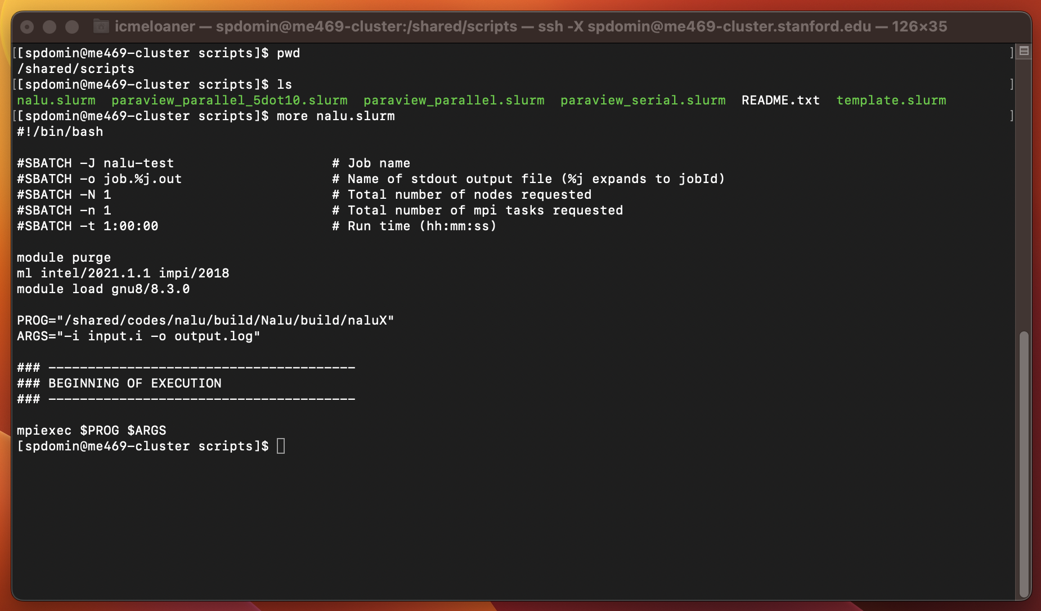
Submission Script >sbatch nalu.slurm >squeue

Slide 8
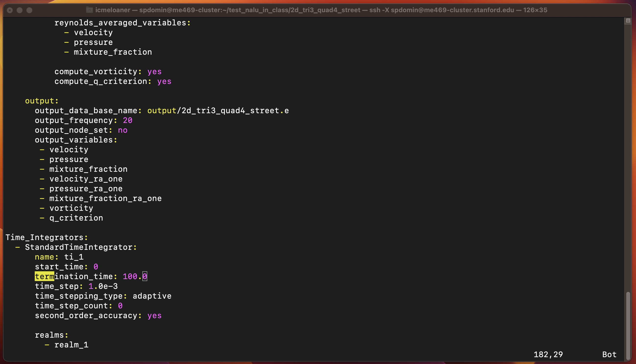
Nalu’s Termination Time

Slide 9
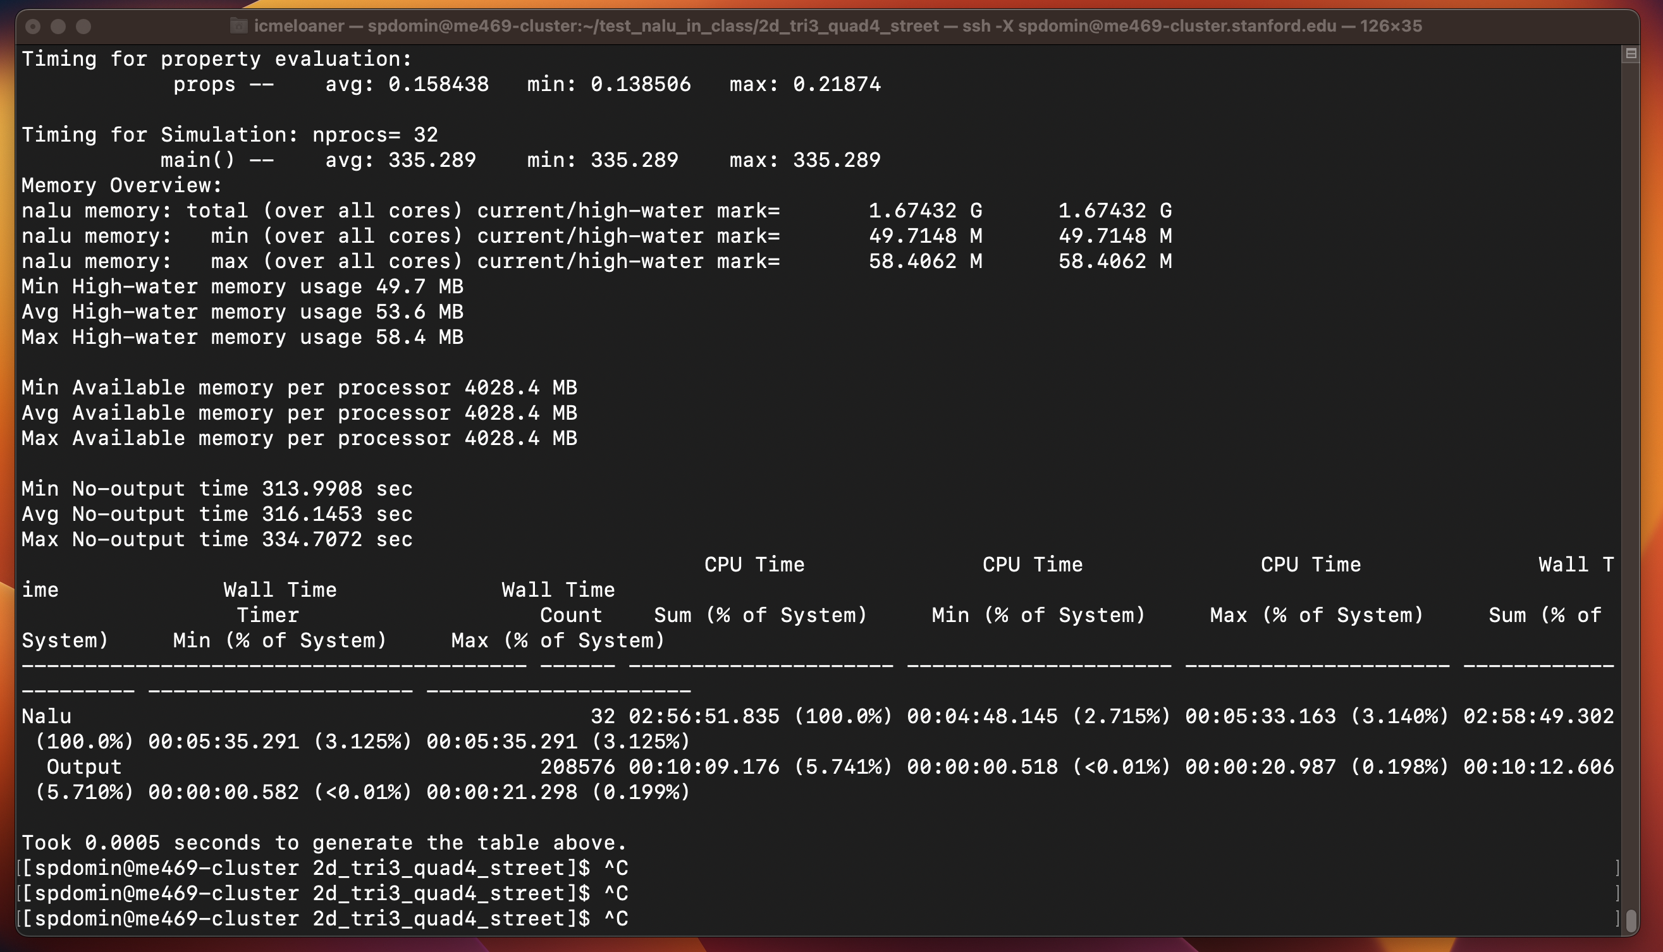
“tail” (while the simulation is running) >tail –f output.log

Slide 10
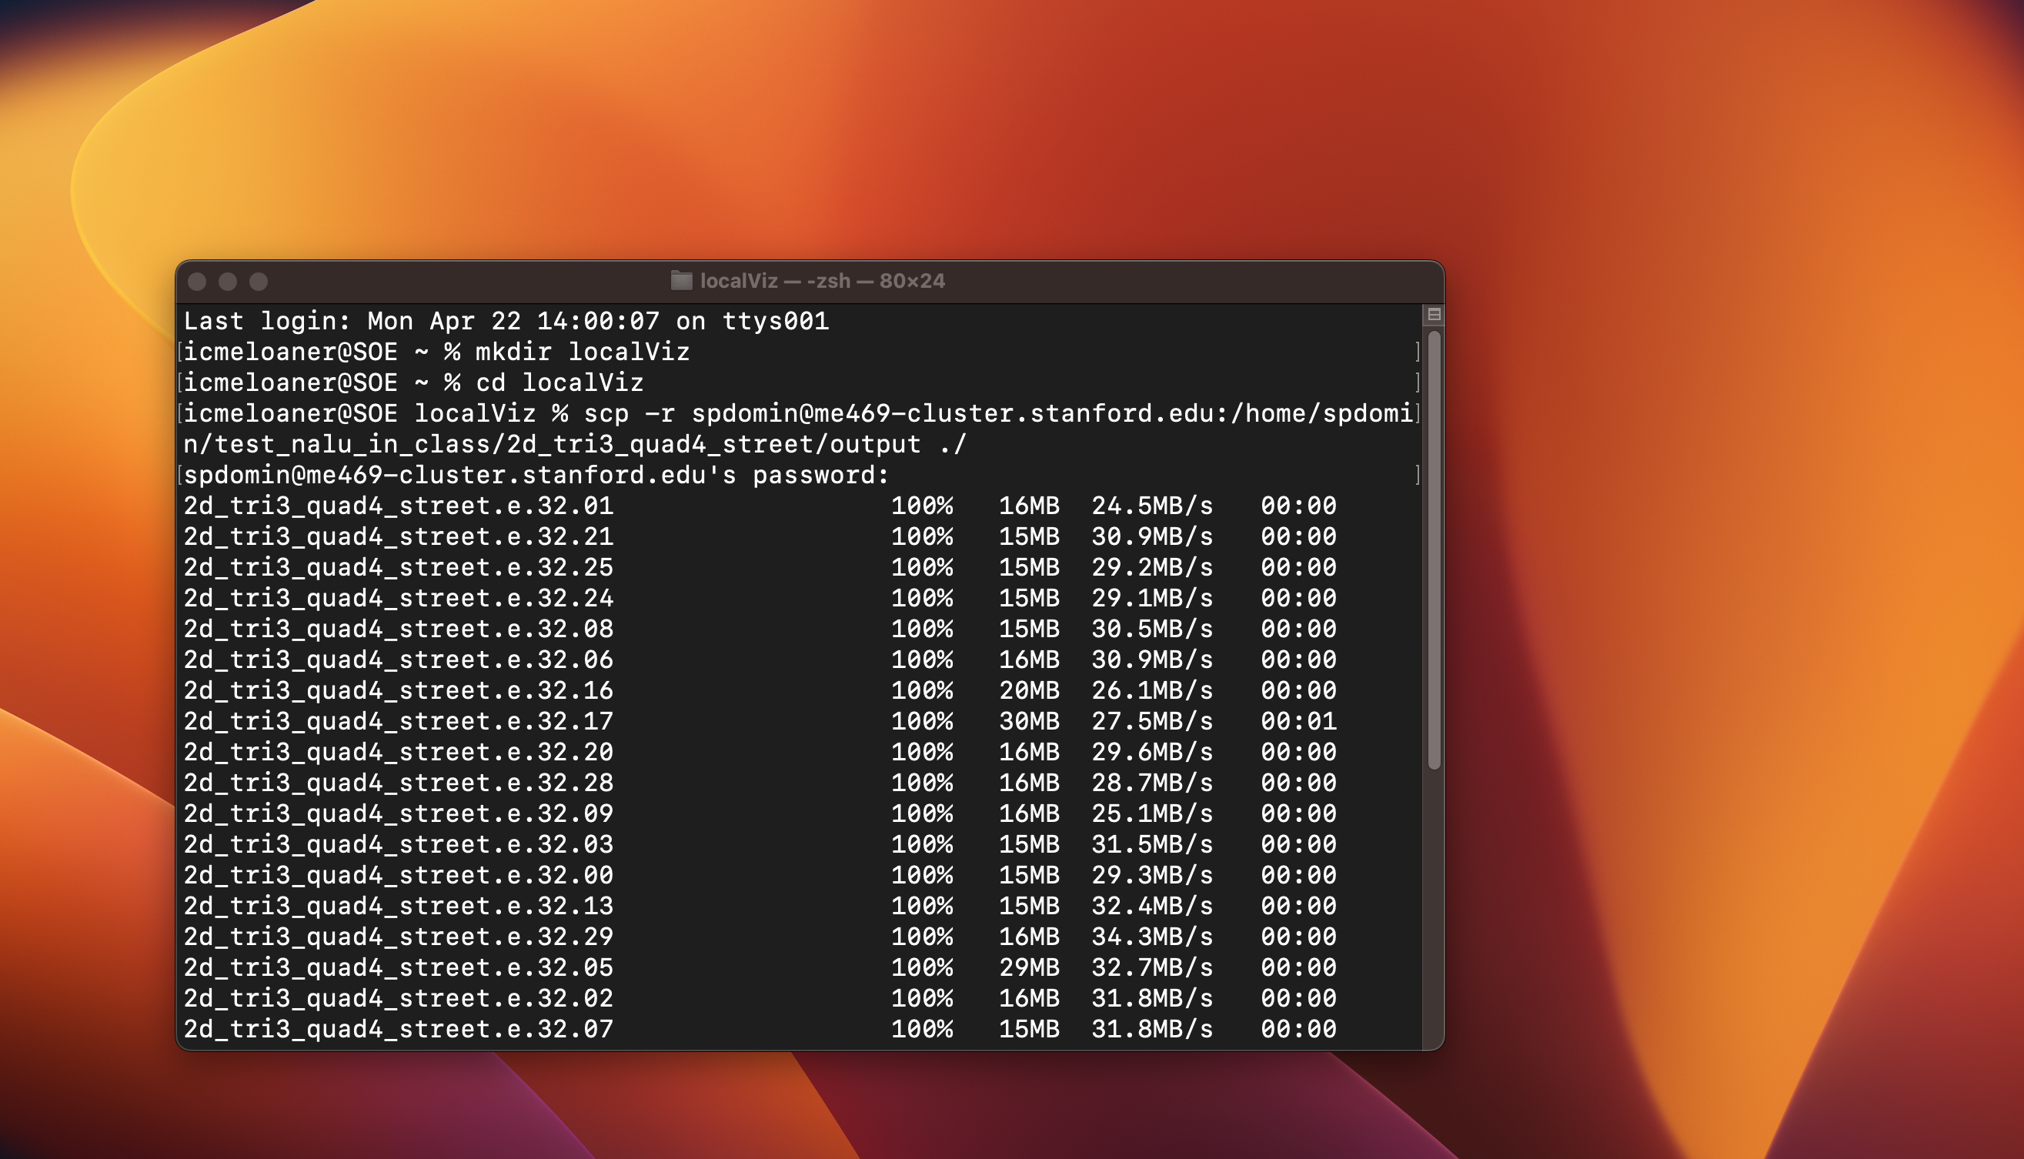
>scp: Copy from cluster to your local viz

Slide 11
Download Paraview
https://www.paraview.org/download/
Version 5.5 may be too old for some systems
I recently downloaded: ParaView-5.12.0-MPI-OSX10.15-Python3.10-x86_64.dmg for my Mac Ventura

Slide 12
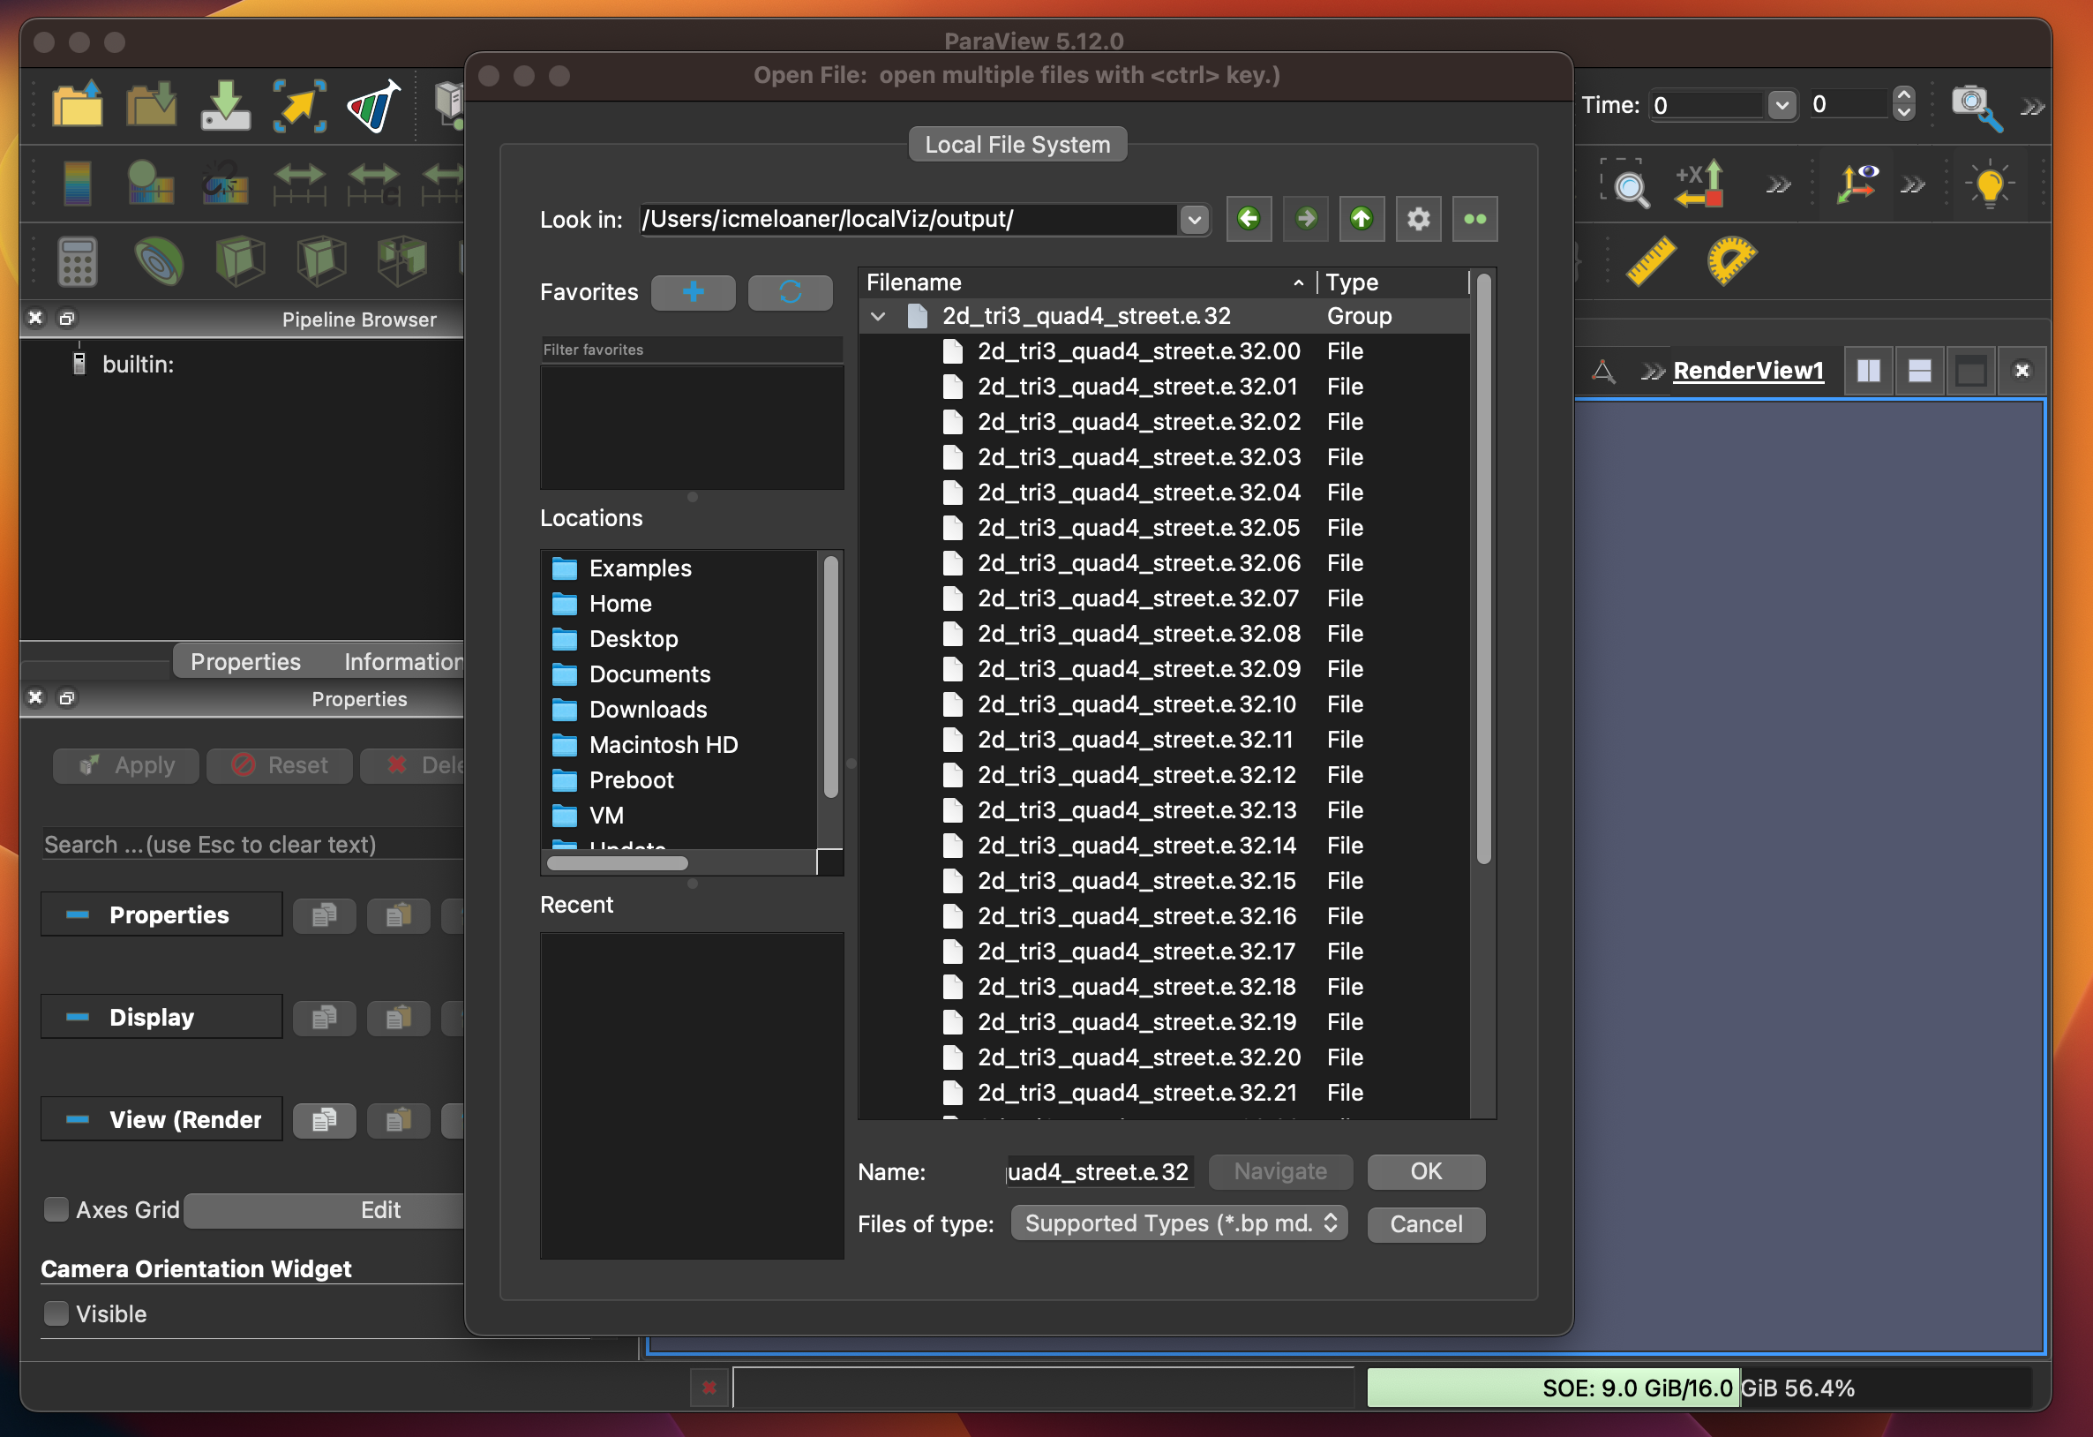
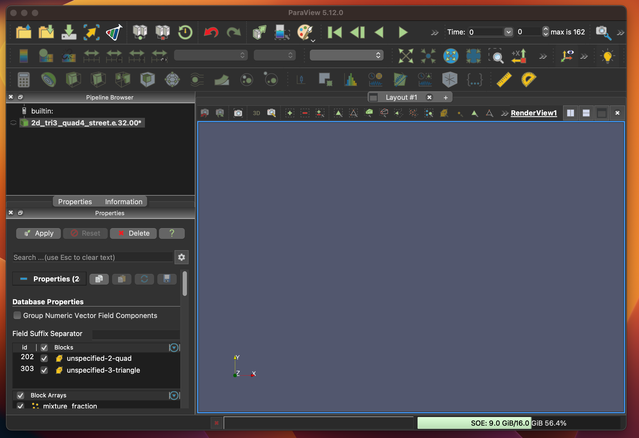
Open Paraview Files

Slide 13
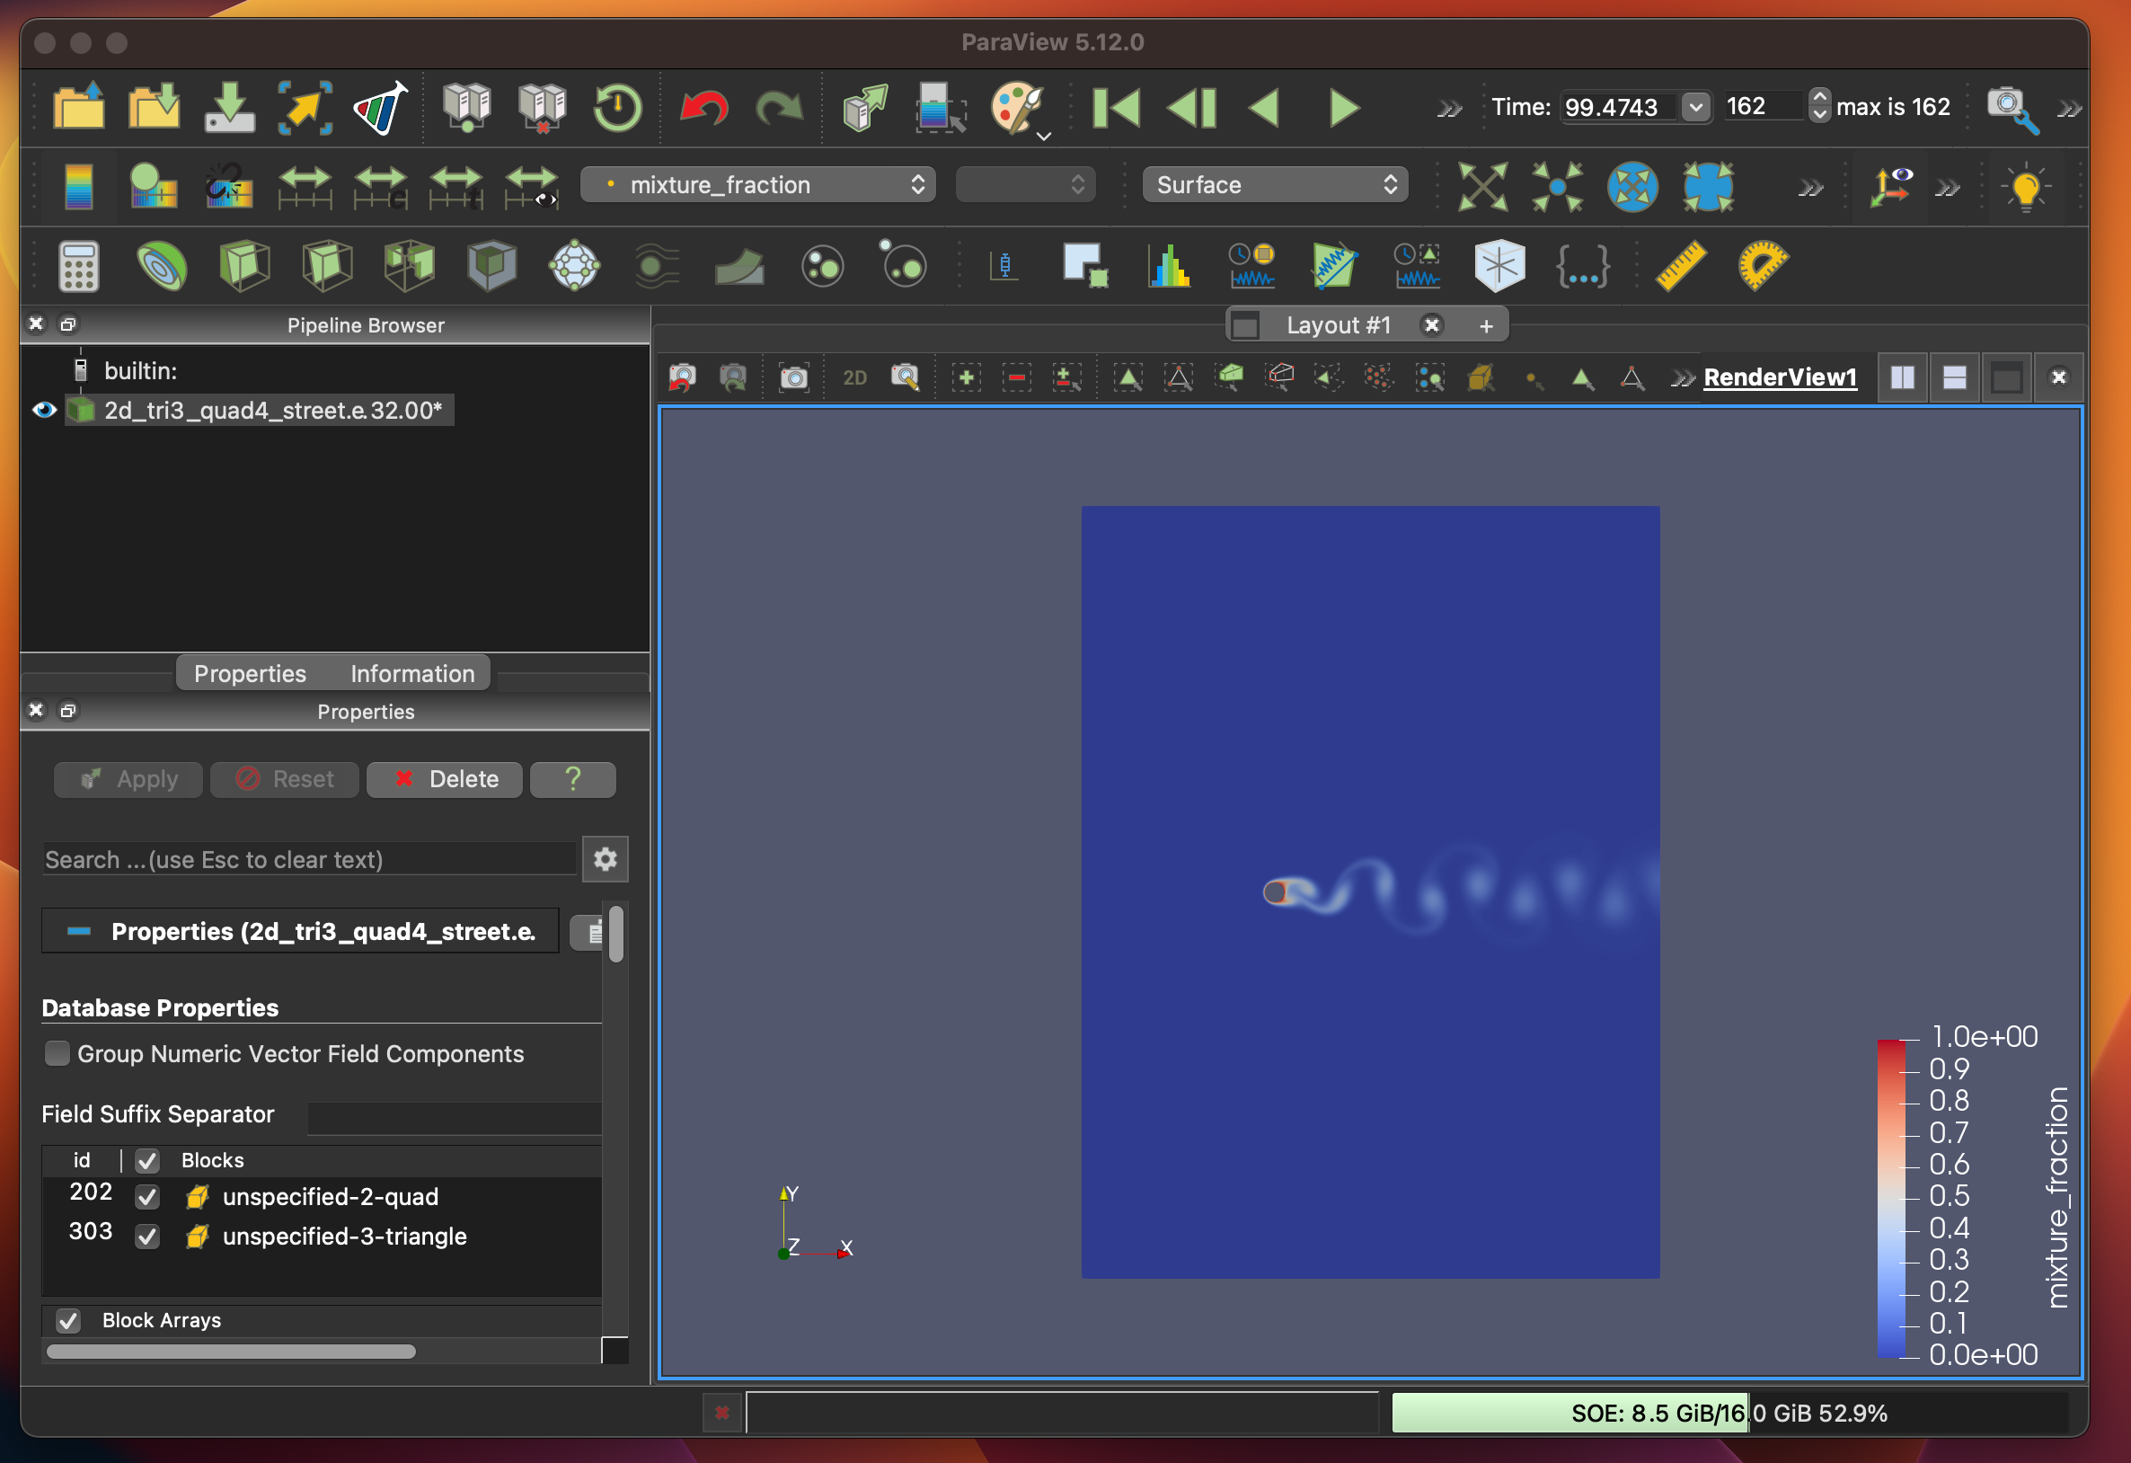
Viz Mixture Fraction

Slide 14
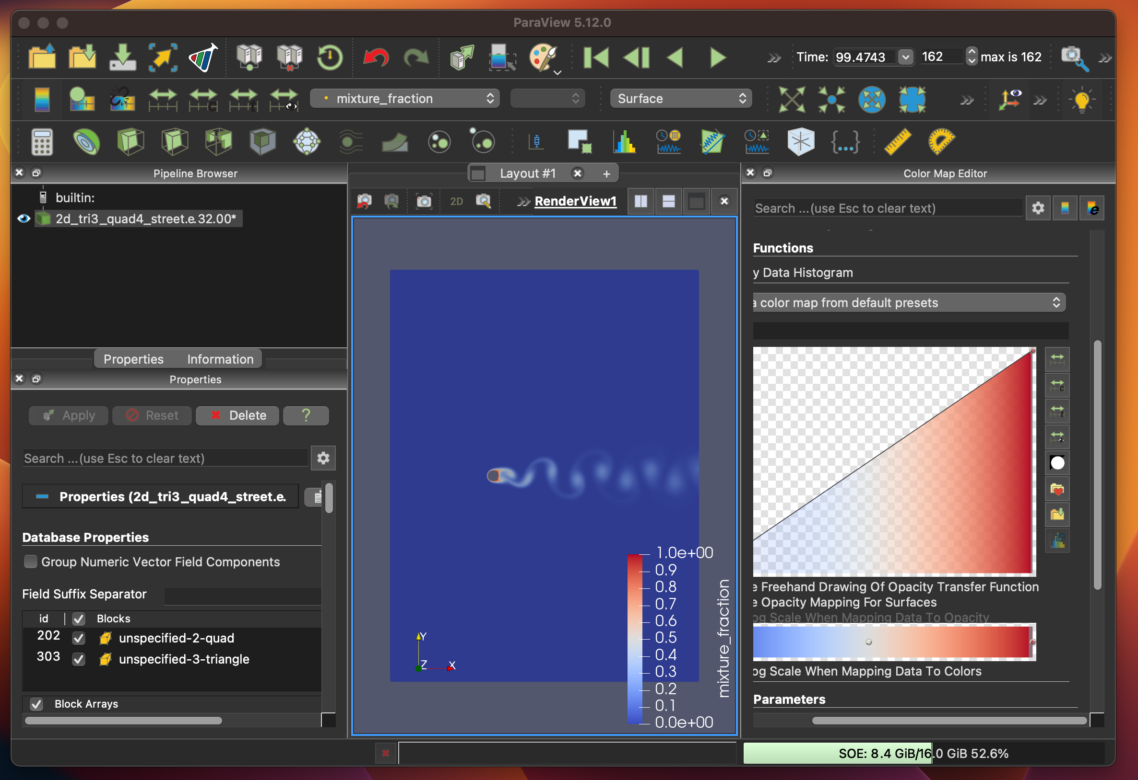
Velocity Shading and Color Palette Change

Slide 15
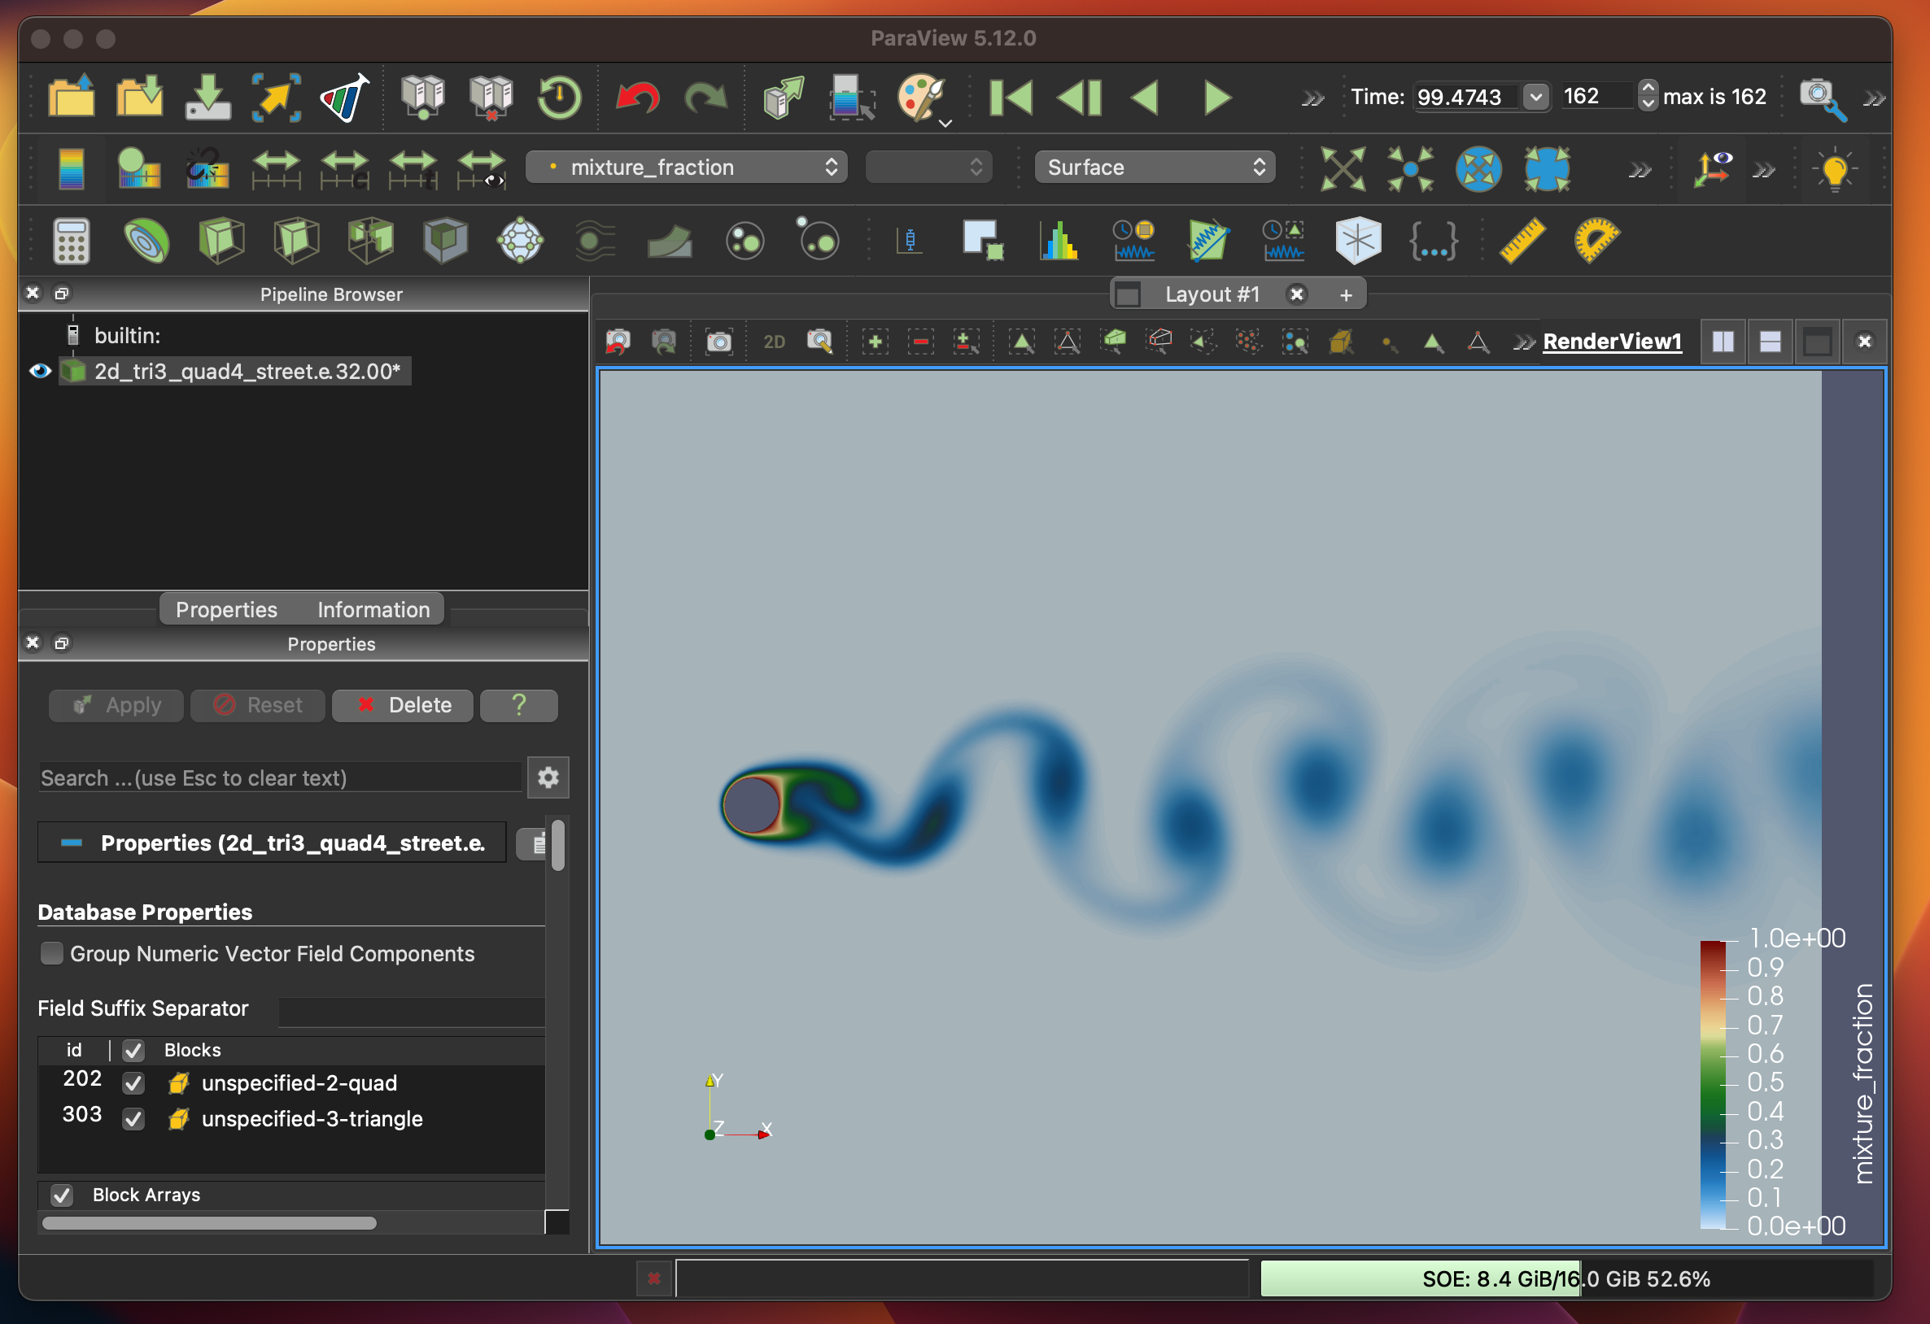
Mixture Fraction Shading with Zoom (via mouse)

Slide 16
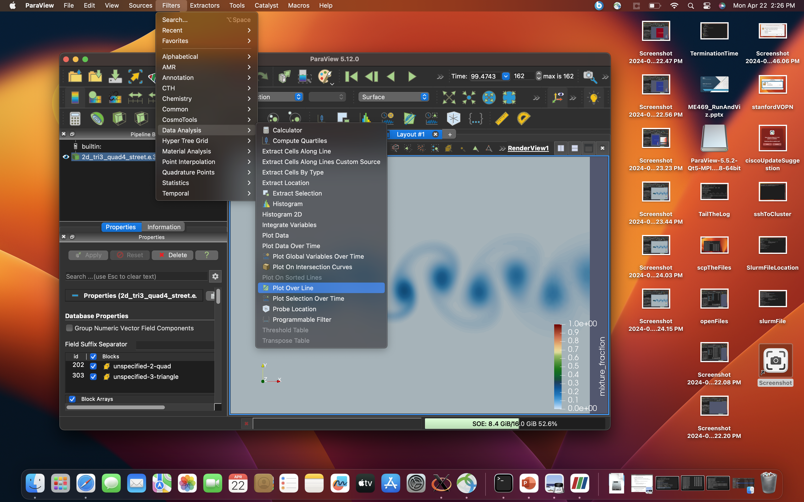
Plot: Filters→Data Analysis→Plot over Line

Slide 17
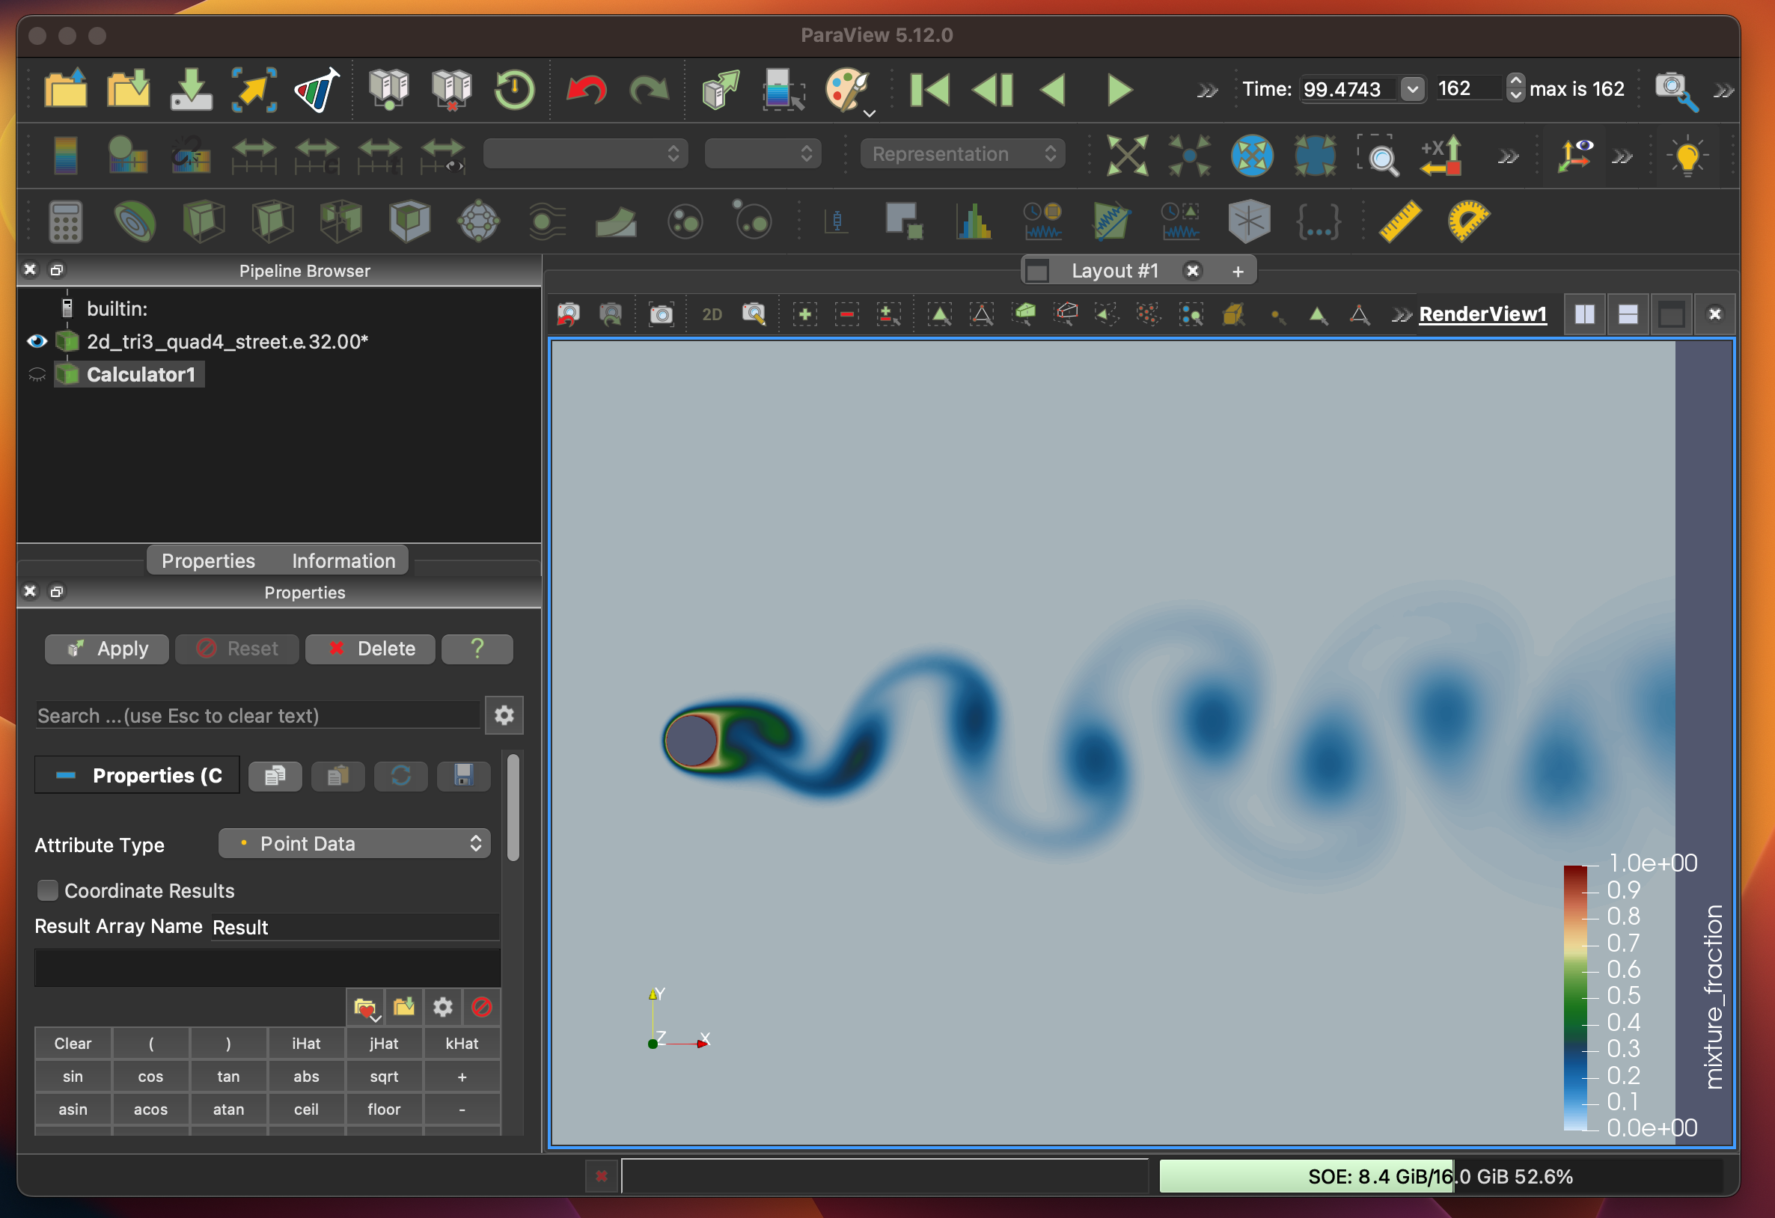
Calculator

Slide 18
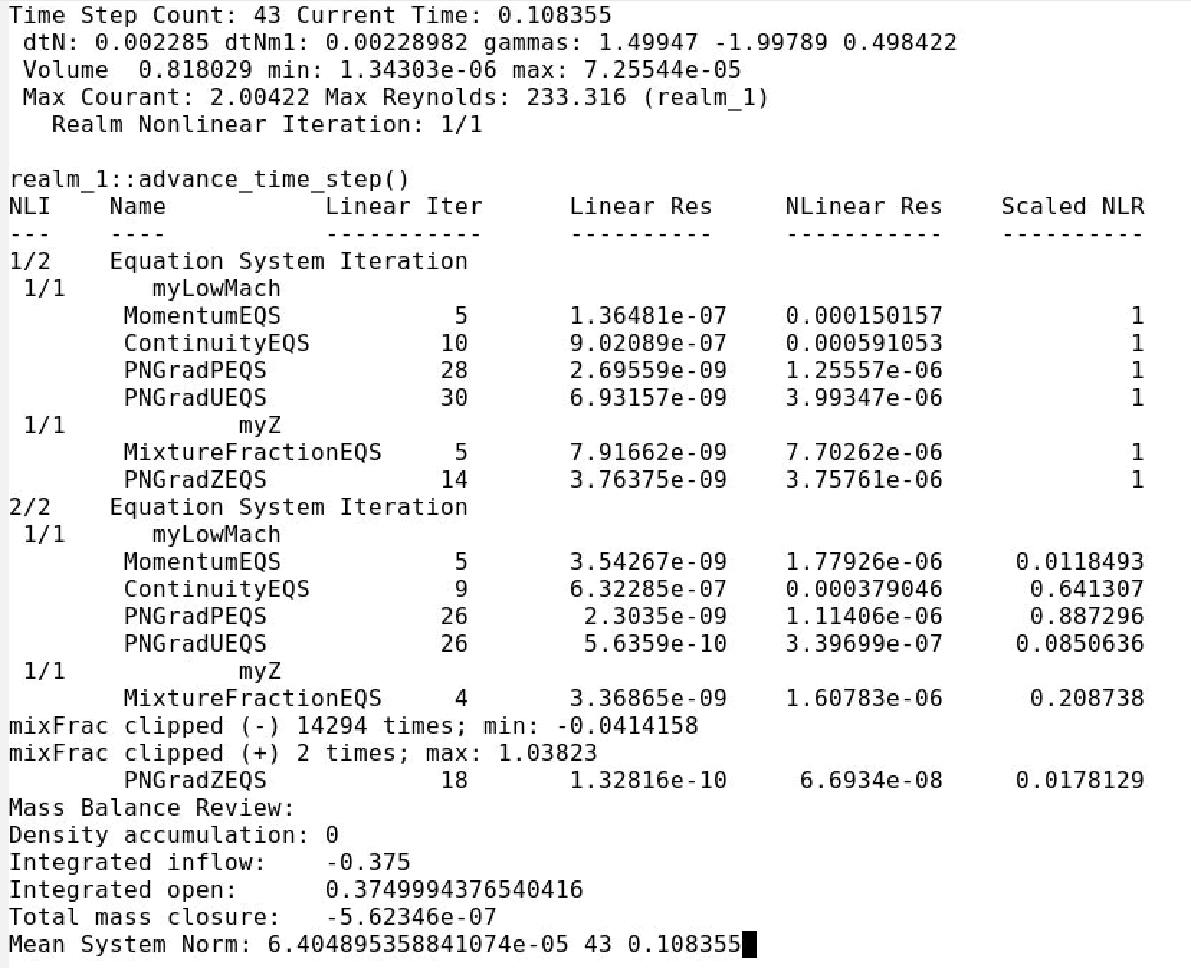
Nalu/reg_tests/test_files/dgNonConformalThreeBlade
γ_{i} for BDF2
UΔt/Δx
ρ U L / μ
Nonlinear
iterations
Equations
Review

